Slide 1
Metaphoric Gesture in
Virtual Agents
Carolyn Saund
University of Glasgow Msc Research Proposal
4 December 2018

Slide 2
Outline
Background/Lit Review
Area our research addresses
Research objectives
Experiment and Methodology
Analysis
Resources
Ethics
Timeline
Potential Challenges
Metaphoric gesture example
Background in agent gesture generation
Constrain by using metaphors
Infer mental states
Experiment: compare communicative meaning of gestures
Resources
Ethics
Timeline
Challenges

Slide 3


Slide 4
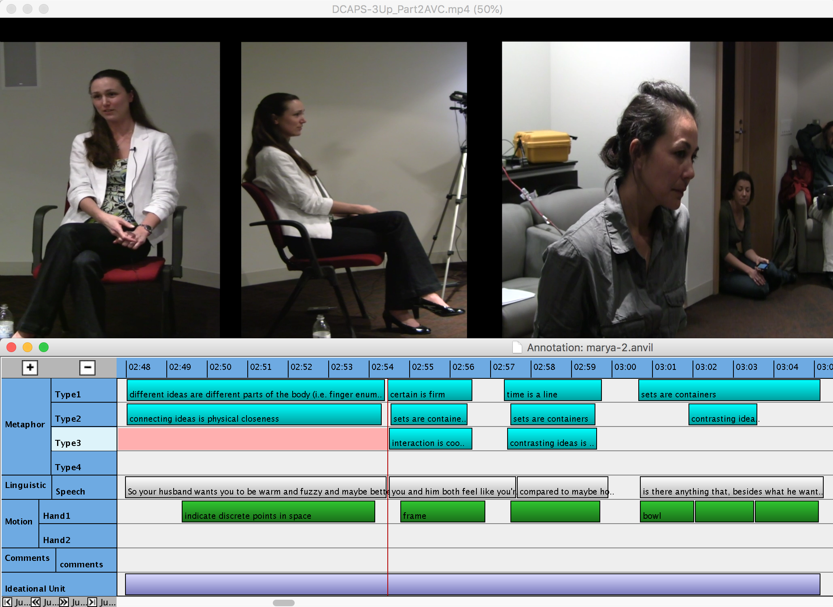
Annotation
Language
Gestures
Metaphors

Slide 5
Annotation
Language
Gestures
Metaphors

Slide 6
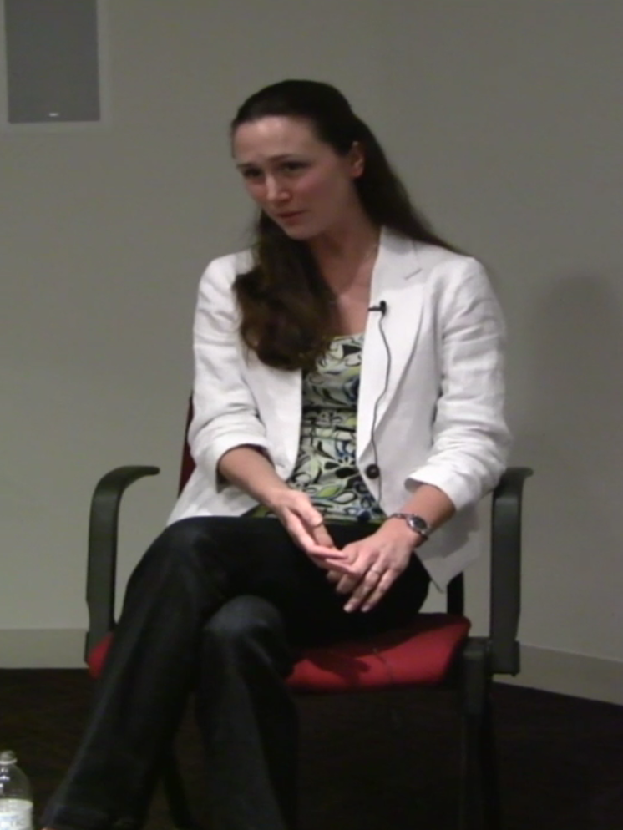
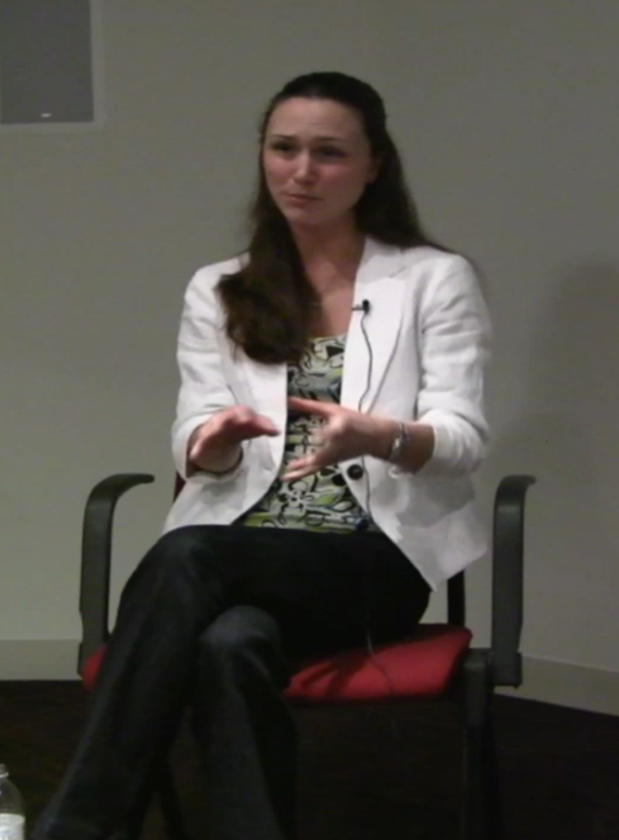
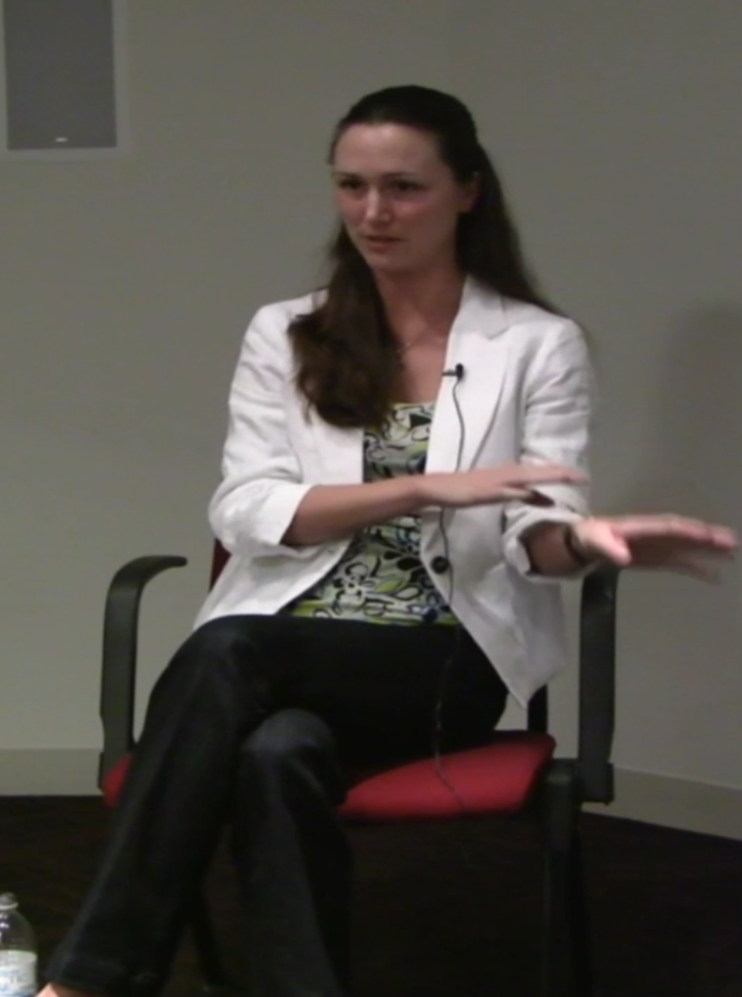
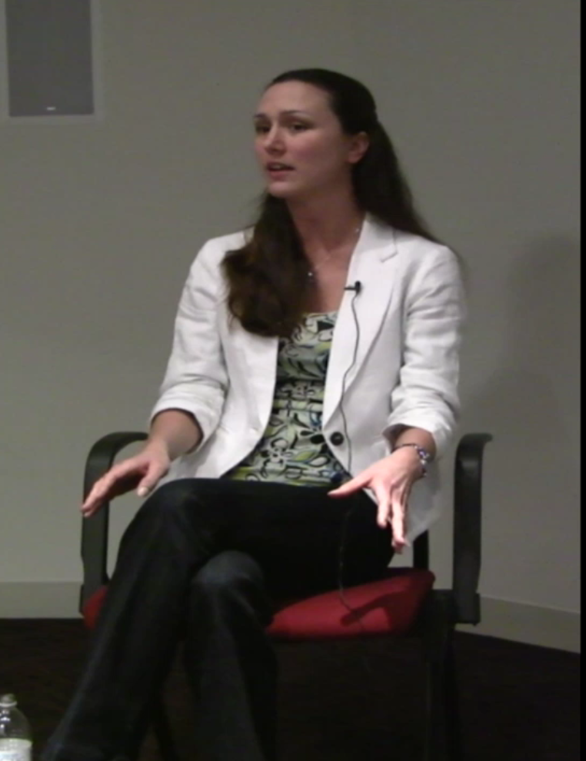
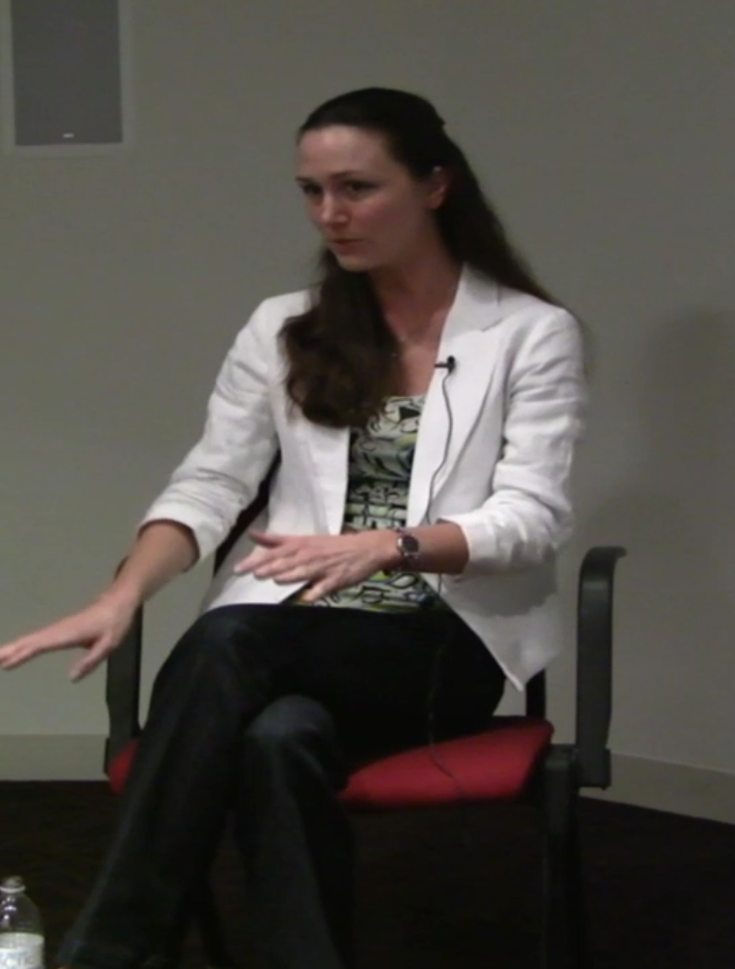
Annotation
Language
Gestures
Metaphors
“So your husband wants you to be…”
“And you and him both feel a little bit like…”
“Distant compared to how you used to be in the past”
“Is there anything at all...”
“Besides what he wants”

Slide 7
Modeling Metaphoric Gestures
Gesture is a rich area of study in communication (McNeill 1992) and understanding linguistics
Metaphoric gestures precede language (McNeill 2000)
Language and Gesture come from same place (Kendon 2000)
Gesture form and function is extensively characterised (Calbris 2011)
Notes:
What are they?
See Carolyn.

Slide 8
Metaphoric Gestures in Virtual Agents
Gestures influence the way we think (Jamalian & Tversky 2012)
Virtual Agents that use human-like gestures have increased communicative ability
Deep-Learned (Yoon et al. 2016)
Cognitively informed (Cerebella) (Lohmmet, Xu, & Marsella 2015)
Rich history in Embodied Cognition
Image Schema Combinations (Hedblom 2016)
Gesture generation from image schemas (Ravanet, Clavel, & Pedichaud 2018)
Notes:
Classical Cognitive Architectures fail to include embodiment at all imo
“Cognitively Informed” → Cerebella

Slide 9
Metaphoric Gestures in Virtual Agents

Slide 10
Missing Elements
Gesture is an entry point to thought
Can we infer internal state based on gesture?
Can we reason about thinking from metaphors?
Can we dynamically recombine metaphors to produce recognizable gestures?
Widely acknowledged the same mechanism (metaphor) must be generating language AND gesture
How do humans actually interact with agents that gesture metaphorically?
Can humans reconstruct the metaphors? How do we extract interpretations from them?
Are metaphors a good heuristic to dramatically reduce data required to produce humanlike gestures?
Spoiler alert: Yes.
Notes:
(timing -- gesture precedes language) but that is super holy grail stuff.
Prior work has only ONE image schema at a time, but for example, how do we communicate multiple concepts or complex concepts with one gesture? How do we re-use gestures for different metaphors?
Is it more natural with metaphors? Are humans able to decode all the metaphors?
Constraining space obviously smart -- we have tons of filters in our brain to get rid of irrelevent information, so this could be viewed as a heuristic to constrain the search space. As an aside, I’m exploring how to harness this for machine learning -- have a computer be forced to use the metaphor as a smaller search/generative space with some sort of category formation attatched.

Slide 11
Research Objectives
Tie language to metaphors known to be prevalent in gesture space
E.g. “That was before my time” → Time is a Line
Create a distinctly human-like metaphoric gesture generator for virtual humans in SmartBody software, based on language inputs
Document metaphoric gestures as an entry point to what happens during thought
Understand the rules of an organized mind
Are there schematic rules about the combinatorics of metaphors? What happens when we break those rules? How does composability influence interpretation?
Are humans able to recover the meaning of generated gestures?
Are metaphoric schemas (or image schemas) a robust way to reason about people’s thoughts?

Slide 12
Experiment and Methodology
Create novel gesture generator
Metaphorically-focused
Language-to-metaphor rhetorical mapping
Discrete gestures that can be blended for each metaphor
Building off of Yuyu (cite) and Ari (cite)
SmartBody software
Demo here
Crowdsource judgements of gesture
mTurk
show videos and have participants extract information and rate on human elements
STRETCH: Dynamically manipulate gestures to determine salient semantic features
Analyse interpretability of randomly generated gestures
Draw strongly from FAU research (Jack)

Slide 13
Language
Semantics (concepts)
Syntax
Emotion
Metaphor
Motion Characteristics
Timing
Gesture
Blended animations based on
Metaphor combinatorics
Motion properties

Slide 14
Resources Part I: Novel Gesture Generator
Access to all software (Blender, SmartBody)
Already have versions up and running on personal and lab machines -- non-trivial!
All open-source licenses -- free to use for research
Personal correspondence to software authors and maintainers -- available for tech support
Cost
Software: Free!
Animator: ???
Discrete set of gestures for generator
Selected set of gestures directly from human examples
Could potentially MoCap and convert animations -- more work to be done here
Funded by lab start-up funds

Slide 15
Resources Part II: Human Judgement
mTurk
Implementation and Design
Many design and implementation experts (Dan, Yuyu, Mathieu) all around
Crowdsourcing Reliability -- benefit of working in virtual agents
Common practice at many institutions
Accepted as reliable for human judgement in the field
Purposefully broad range of participants
Cost
Estimations
300 participants
~$200 (5 min/participant and $8/hr, minimum wage is $7.25)
~3-4 days of data collection based on prior experiences
Funded by lab start-up funds

Slide 16
Resources Part III (Stretch):
Gesture Manipulation
Hello software my old friend
Same basic software as before
Blend arbitrary metaphors
With random parameters (speed, height, animation functions)
I’ve come to use mTurk again
How much can people interpret metaphoric gestures that are NOT generated through language?
What do people think they mean?
Do they interpret language/meaning correctly with randomly blended gestures?
Same mTurk setup as before

Slide 17
Analyses
Subjective ratings of generated gestures vs. organic ones on key elements
7 main traits for socially interactive robots (Fong et al. 2003)
Ex. Shared Reality (Hoffman & Breazeal 2007)
“How close do you feel to the robot?”
“How much fun was this robot to interact with?”
Ex. Future contact intentions (Bartneck et al. 2009)
“Would you like to live with the robot?”
Extraversion (Neff et al. 2010)
Personality traits, believability (Kramer, Simons, & Kopp 2007)
Attentive, amused, cheerful, relaxed, lethargic
Warm-hearted, self-confident, enthusiastic
Notes:
Meaning, then attitudinal interpretation
Maybe take this all out

Slide 18
Analyses
Interpretability of gesture
“How clearly did you understand what the agent said?”
Qualitative:
“What do you think the agent was saying?”
Compare our generated gestures (both actual and arbitrary blends) with actual human gesture, compare how people interpret the gestures.
Example

Slide 19
Timetable
Sept/Oct
Lit Review
Explore different virtual human softwares
Develop Annotation Schema
November
Video Annotation
Exploratory work with gesture parsing
Exploratory work with semantic and rhetoric parsing
POC of Gesture blending
December
Video Annotation
Finalize Gesture Primitive Animation Set
Decide on Root gesture creation
Animator Work bounding
Do MoCap of gesture primitives

Slide 20
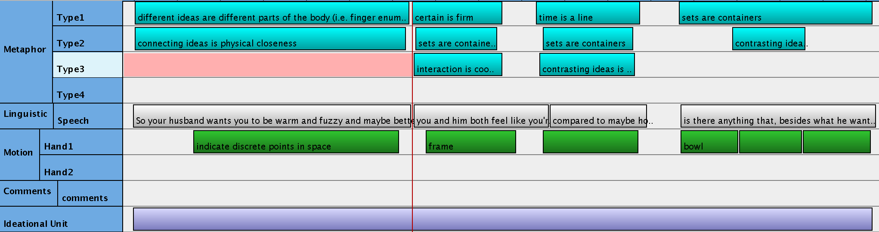
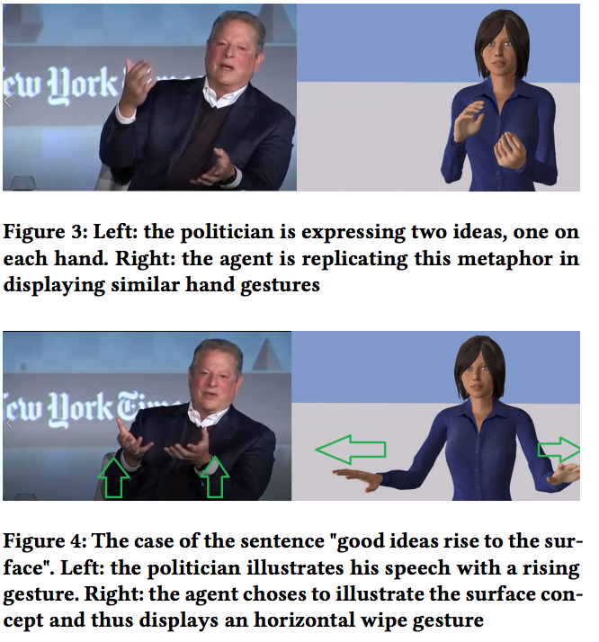
Timetable
Sept/Oct
Lit Review
Explore different virtual human softwares
Develop Annotation Schema
November
Video Annotation
Exploratory work with gesture parsing
Exploratory work with semantic and rhetoric parsing
POC of Gesture blending
December
Video Annotation
Finalize Gesture Primitive Animation Set
Decide on Root gesture creation
Animator Work bounding
Do MoCap of gesture primitives
(Kipp 2001)
(Ravanet, Clavel, & Pelachaud 2018)

Slide 21
Timetable
January
Ethics Approval
Hire animator for gesture generation
Finalize metaphoric gesture set
Finalize gesture blending mechanism
February
Hook up linguistic parser to metaphor generator
Hook up metaphor generator to gesture generator
March
Run mTurk experiment 1 -- gesture interpretability and virtual agent likeability
Start work on dynamic noise generation in gesture generator
Preliminary work with arbitrary metaphor blending
April
Analyse & write up results -- goal to publish at Intelligent Virtual Agents (IVA) 2019

Slide 22
EVERYTHING BEYOND THIS
IS A STRETCH GOAL

Slide 23
Timetable
June
Continue arbitrary blending work
Select clips to test with natural vs. generated vs. arbitrary gestures
mTurk experiment 2 -- arbitrary metaphoric blends
July
Analyse mTurk experiment 2
See if previous interpretability results were any better than random
Write up results, goal to have poster at ISRE (July 10)
August/September
Start Designing MEG experiments for salient feature analysis (Schyns)

Slide 24
Ethical Implications
mTurk
Fair pay, will need to test experiment timing and design pay around time it takes to complete the experiment
May need to adjust pay if we find people are taking longer or shorter than expected to complete tasks
Participant selection: mTurk T&C specify regulations
Quick tasks, intuition-based decisions, not likely to be taxing
Where/how to publish code
Open Science: Code is meant to run wild and free
https://github.com/uofgsocialrobotics

Slide 25
Potential Challenges
Model Data
Work off of gesture parser/labeler (Chiu 2014)
Gesture Blender
Largely building on current work
Crowdsourcing
Common practice at Northeastern, BU (proved reliable in field)
Many design and implementation experts (Dan, Yuyu, Mathieu) all around
Catastrophic Failure Ejection Pod
There’s still a new gesture generator!
Publish that bad larry -- implications in agent design
Therapeutics
Entertainment (gaming, VR)
Negative findings may indicate:
Lack of maturity of gesture space
Poor mapping of language to metaphor
“we need to go deeper” -- Nolan et al. 2010

Slide 26
References
Bartneck, C., Kulić, D., Croft, E., & Zoghbi, S. (2009). Measurement instruments for the anthropomorphism, animacy, likeability, perceived intelligence, and perceived safety of robots. International journal of social robotics, 1(1), 71-81.
Calbris, G. (2011). Elements of meaning in gesture (Vol. 5). John Benjamins Publishing.
Chiu, C. (2014). Generating Gestures from Speech for Virtual Humans Using Machine Learning Approaches (Master's thesis, University of Southern California, 2014). Ann Arbor, MI: ProQuest LLC. doi:3644586
Fong, T., Nourbakhsh, I., & Dautenhahn, K. (2003). A survey of socially interactive robots. Robotics and autonomous systems, 42(3-4), 143-166.
Hedblom, M. M., Kutz, O., & Neuhaus, F. (2016). Image schemas in computational conceptual blending. Cognitive Systems Research, 39, 42-57. doi:10.1016/j.cogsys.2015.12.010
Hoffman, G., & Breazeal, C. (2007, March). Effects of anticipatory action on human-robot teamwork efficiency, fluency, and perception of team. In Proceedings of the ACM/IEEE international conference on Human-robot interaction (pp. 1-8). ACM.
Jamalian, A., & Tversky, B. (2012, January). Gestures alter thinking about time. In Proceedings of the Annual Meeting of the Cognitive Science Society (Vol. 34, No. 34).
Kendon, A. (2000). Language and gesture: Unity or duality. Language and gesture, 2.
Kipp, M. (2001) Anvil - A Generic Annotation Tool for Multimodal Dialogue. Proceedings of the 7th European Conference on Speech Communication and Technology (Eurospeech), pp. 1367-1370.
Krämer, N. C., Simons, N., & Kopp, S. (2007, September). The effects of an embodied conversational agent’s nonverbal behavior on user’s evaluation and behavioral mimicry. In International Workshop on Intelligent Virtual Agents (pp. 238-251). Springer, Berlin, Heidelberg.

Slide 27
References
Lhommet, M., Xu, Y., & Marsella, S. (2015, January). Cerebella: Automatic Generation of Nonverbal Behavior for Virtual Humans. In AAAI (pp. 4303-4304).
McNeill, D. (1992). Hand and mind: What gestures reveal about thought. University of Chicago press.
McNeill, D. (Ed.). (2000). Language and gesture (Vol. 2). Cambridge University Press.
Neff, M., Wang, Y., Abbott, R., & Walker, M. (2010, September). Evaluating the effect of gesture and language on personality perception in conversational agents. In International Conference on Intelligent Virtual Agents (pp. 222-235). Springer, Berlin, Heidelberg.
Nolan, C., Thomas, E., DiCaprio, L., Watanabe, K., Gordon-Levitt, J., Cotillard, M., Page, E., ... Warner Home Video (Firm). (2010). Inception.
Ravenet, B., Clavel, C., & Pelachaud, C. (2018, July). Automatic Nonverbal Behavior Generation from Image Schemas. In Proceedings of the 17th International Conference on Autonomous Agents and MultiAgent Systems (pp. 1667-1674). International Foundation for Autonomous Agents and Multiagent Systems.
Salem, M., Eyssel, F., Rohlfing, K., Kopp, S., & Joublin, F. (2013). To err is human (-like): Effects of robot gesture on perceived anthropomorphism and likability. International Journal of Social Robotics, 5(3), 313-323.
Yoon, Y., Ko, W. R., Jang, M., Lee, J., Kim, J., & Lee, G. (2018). Robots Learn Social Skills: End-to-End Learning of Co-Speech Gesture Generation for Humanoid Robots. arXiv preprint arXiv:1810.12541.

Slide 28
Questions

Slide 29
Annotate Video
Build Model
Put model in Virtual Humans
Systematically evaluate gestures

Slide 30
Thought
Language
Gesture
“Is there anything at all, besides what he wants, anything that you want to do.”
Construct a set of things to talk about
“Anything”
it’s a large set
“Besides what he wants”
Separated ideologically
Not in the set of things to talk about
Close off area
create container for set
Two-handed (large) sweep indicating size
Mime “removing” from container
Physically separate hands

